Slide 1
Status of BISMV

Slide 2
Final configuration and beam sizes to be confirmed
Also,
Dump types (Int. / Ext. ?), positions, thermal issues, etc
Gap width and Height, trajectory, angles, etc
BISMV simulations with Flux2D
BISMV parameters used
Septum 4 mm
Gap width 55 (vertical beam acceptance)
Rear conductor thickness 10 mm
Gap height 70 mm (horizontal beam acceptance)
Play between septum and yoke 0.05 mm
Cooling tube diameter 2 mm
Steel used VM111ISO
Required delfection 170 mrad
Assumed Leq 960 mm
B.dl required 323 mT.m
Required gap field 376 mT
Required current 19 kA
Available Lphysical 1000 mm
The latest model which has been compiled by Bruno has the following parameters.

Slide 3
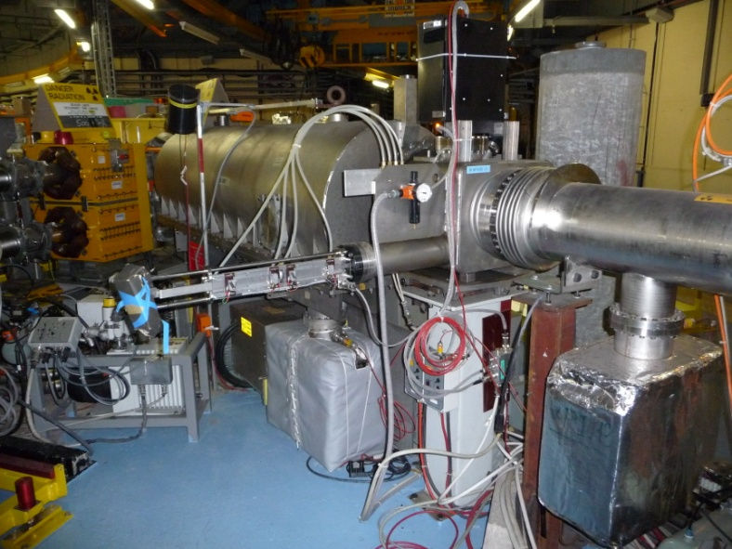
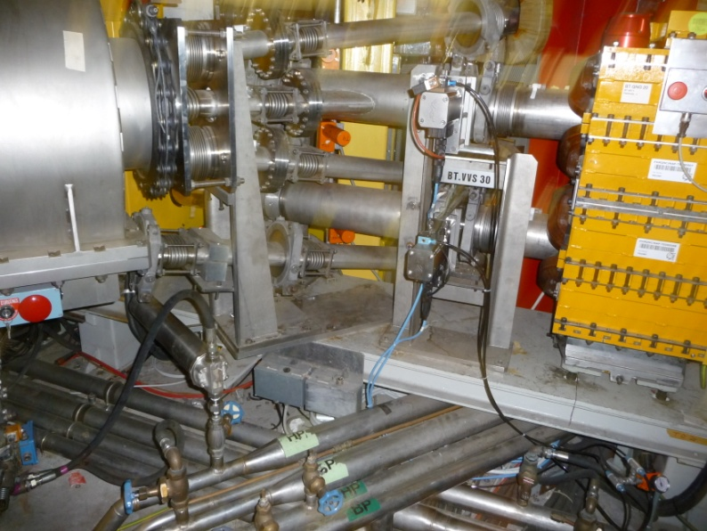
Proposition 2010
Note: Dumps are still present in this configuration.
Beam entry from Distributor
Beam Exit towards 4 rings of PSB

Slide 4
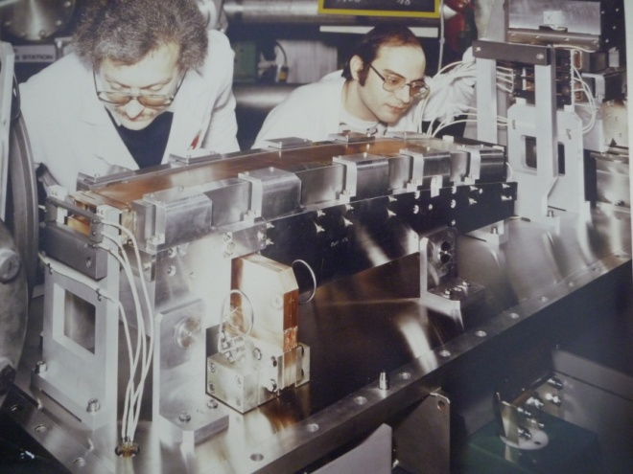
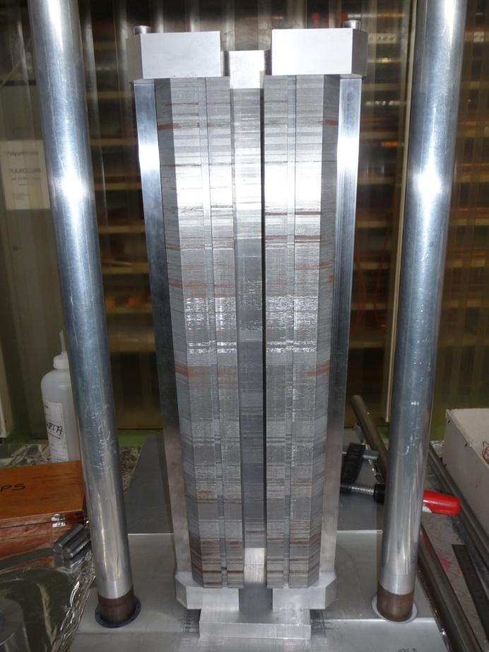
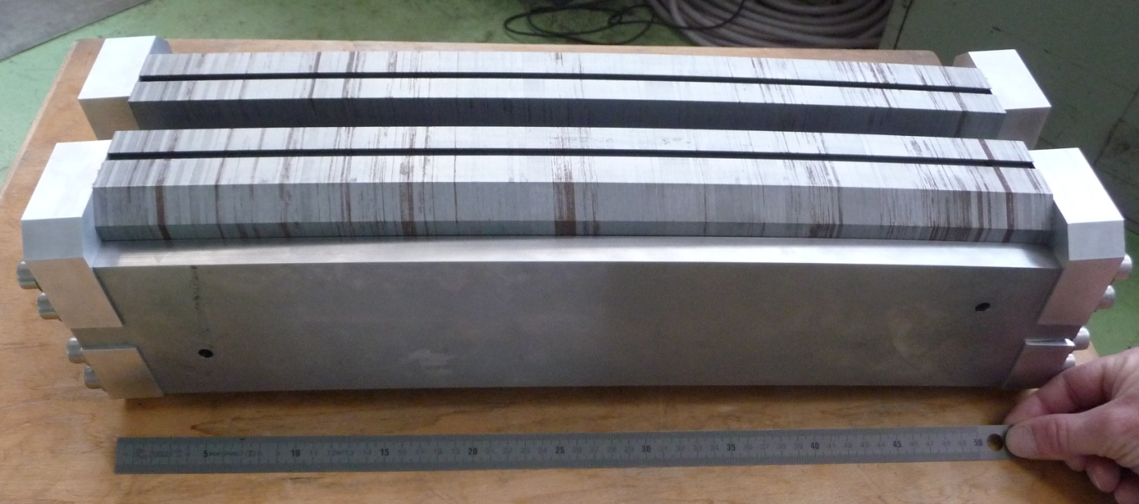
Original magnets (Ferrites-Curved)
Curved magnet yoke assembled and verified.
Alignment of laminations are good and this yoke could be used to house a curved coil.
Curved yoke aligned by 2 side mounted precision machined guide plates.

Slide 5
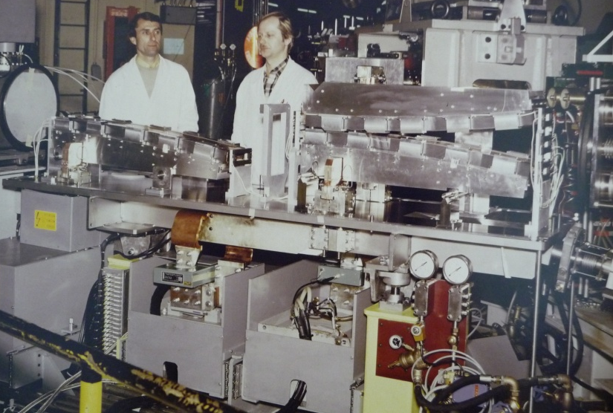
The “Omega” vacuum tank will be replaced by a circular type with wheeler type flanges.
Magnets will be static-having been previously aligned in the lab and referenced to external target points.
The cooling and power will be supplied via a standard high current UHV feedthrough as used on the pulsed septa in the PS complex.
The magnets will be baked using infra red light systems as used in the PS. (Reliable, proven, and standard modular units which are easily exchanged.

Slide 6
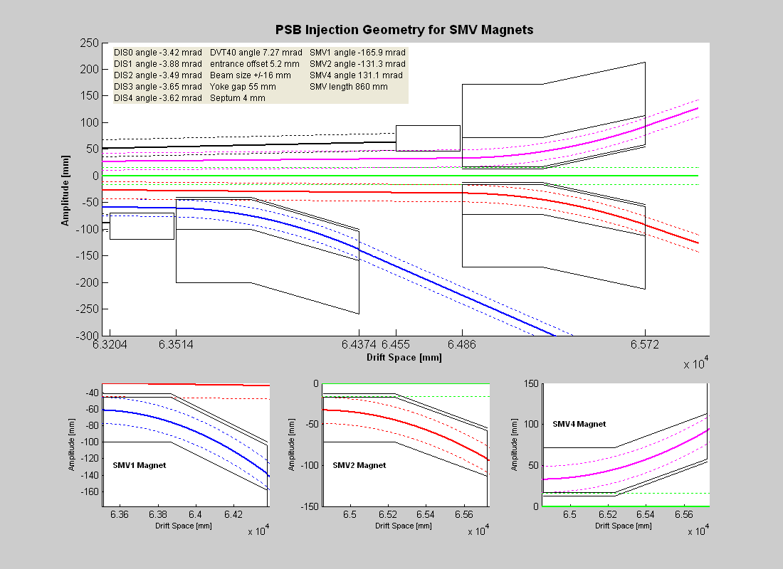

Slide 7
Planning
New Baseline established in EVM for BISMV
Prototype yoke and coil end 2010
All mechanical drawings finished end 2010
Vacuum vessels delivery early 2011
Coil production finished March 2011
Magnet assembly finished mid 2011
System Assembled Oct 2011
Testing finished Dec 2011

