Slide 1
Eddy current effects in the PSB injection area
J. Borburgh

Slide 2
Eddy currents induced in yoke
Assuming a pulse with a rise, fall time and flat top of 1 ms each, 0.35 mm thick laminations, and constant average field (1 T) in yoke:
B gap (T) | Field delay (µs) | Field error (mT) | Relative field error (%) | Skin depth (mm)
0.30 | 0.13 | 0.04 | 0.013 | 0.48
0.35 | 0.12 | 0.04 | 0.012 | 0.48
0.75 | .008 | 0.06 | 0.008 | 0.48

Slide 3
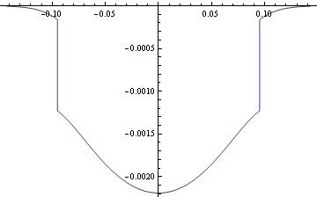
Eddy currents in vacuum chamber
Assume vacuum chamber 190 x 70 mm (for ex. For BS2) internally, made of corrugated inconel, sitting inside 80 mm magnet gap
dB/dt (T/ms) | Max. dB (mT) | Field delay (µs)
0.3/1 | 19 | 62.6
0.35/1 | 22 | 62.6
0.35/10 | 2.2 | 62.6
0.75/1 | 43.5 | 62.6

Slide 4
Predetermination | BS1
INPUT data |  |  |  | RESULTS | PROTONS
PARTICLES |  |  |  | rest mass mo | 0.93826 | GeV/c2
Particle type: electrons, protons: ions | p |  |  | Kinetic energy | 0.1600 | GeV
Momentum, kinetic energy, beam rigidity | ec |  |  | Beam momentum | 0.5708 | GeV/c
Kinetic energy Ec = | 0.16 | GeV |  | beta | 0.5198
 |  |  |  | gamma | 1.1705
 |  |  |  | beta*gamma | 0.6084
Required deflexion | 72 | mrad |  | Brho | 1.9040 | Tm
 |  |  |  | Rho | 5.490 | m
Septum thickness | 10 | mm |  | Intergrated field BdL | 0.137 | T.m
Gap Heigth | 80 | mm |  | Induction in gap | 0.347 | T
Gap width | 140 | mm |  | Magnetic field H=B/uo | 2.76E+05 | A/m
Magnetic length | 395 | mm
Rear conductor thickness | 10 | mm |  | Required current | 1840 | A
Heigth rear conductor | 80 | mm |  | I rms | 117 | A
# of turns | 12 | turns |  | Rms current density septum | 2.22 | A/mm2
 |  |  |  | Rms current density rear conductor | 2.22 | A/mm2
Drift space length | 0 | mm |  | Magnet resistance | 5.89 | mOhms
 |  |  |  | Magnet inductance | 116.1 | uH
Copper resistivity ( 1.72E-2) | 0.0172 | mO.mm |  | Power consumption | 0.081 | kW
Youngs modulus (12500) | 12500 | daN/mm2 |  | Magnetic energy stored in the gap | 197 | J
Current pulse shape
DC, half sine, trapezoidal | t
rise time = fall time | 1 | ms |  | Beam displacement after drift space | 14 | mm
flat top | 3 | ms
Repetition time (total cycle) | 0.9 | s |  | Lamination dimensions
repetition rate of the current pulse | 1.1 | Hz |  | Gap width | 140 | p en mm
Cooling circuit parameters |  |  |  | Gap Heigth | 80 | h en mm
septum/return cond. channels in series? | yes |  |  | Lamination width L | 185 | L en mm
water pressure difference (dP) | 12 | bar |  | Lamination height H | 170 | H en mm
total # of cooling channels septum | 12

Slide 5
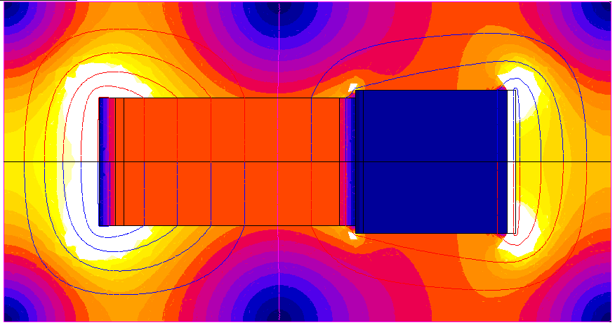
Double aperture septum (BS1/DVT70 Hor.)
In case 72 mrad and 6 mrad would be needed for the BS1 and injected beam repectively, the proposed geometry could use a 12 turn coil around the orbiting beam aperture in series with a single turn coil around the injected beam aperture. Alternatively these apertures could be powered independently, but the effect of the magnetic coupling between the resulting two circuits would have to be studied more carefully.

