Slide 1
BS(1) combined function feasibility study
B. Goddard, J. Borburgh

Slide 2
Assume all magnets 0.37 m long, 66 mrad
  RBEND
  SBEND
  Combined function RBEND
  Combined function SBEND
  SBEND-0.5 angle shim

Slide 3
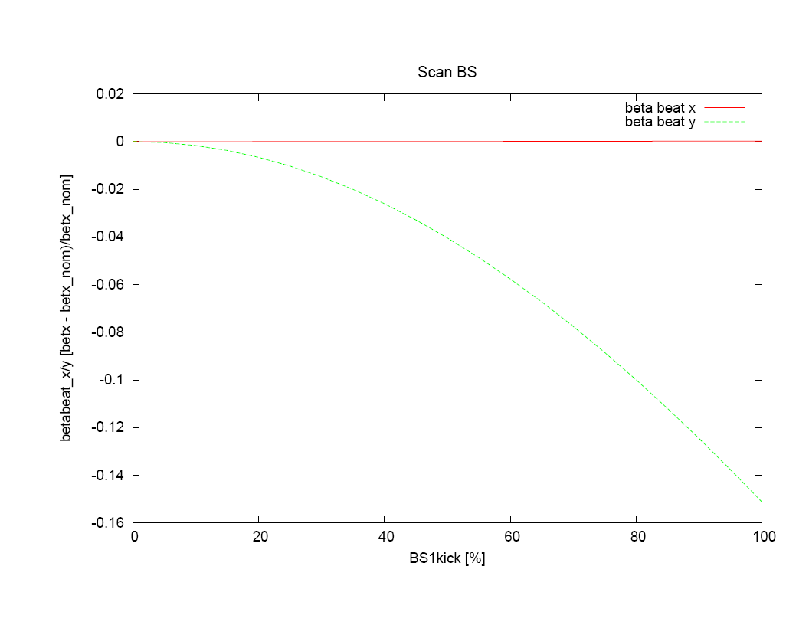
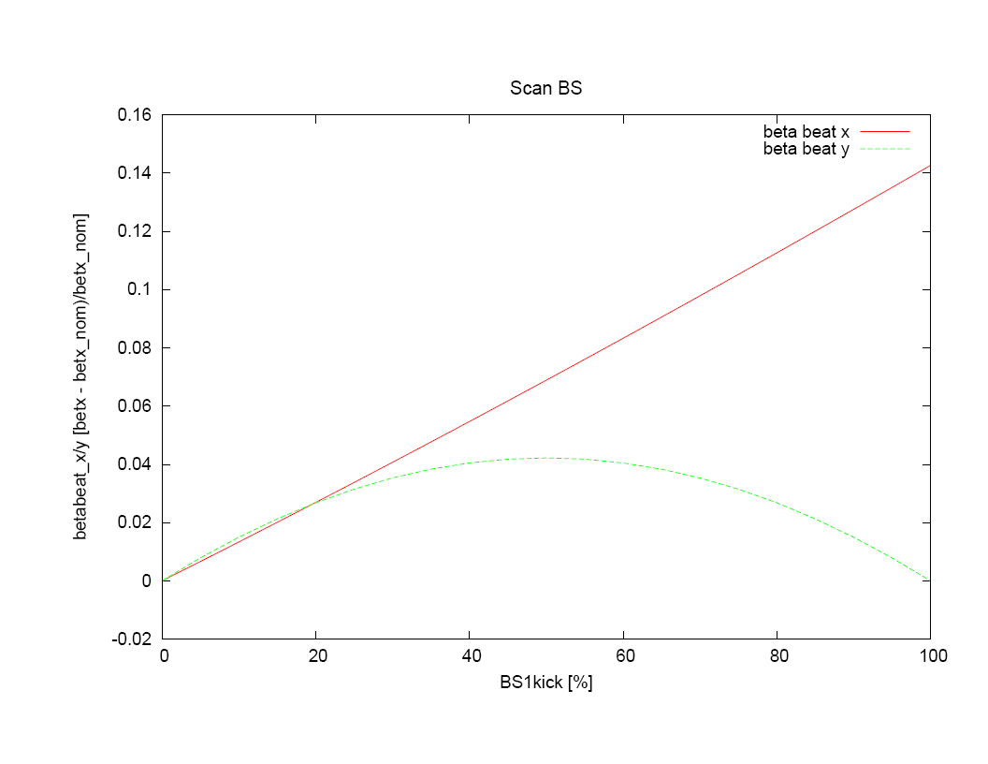
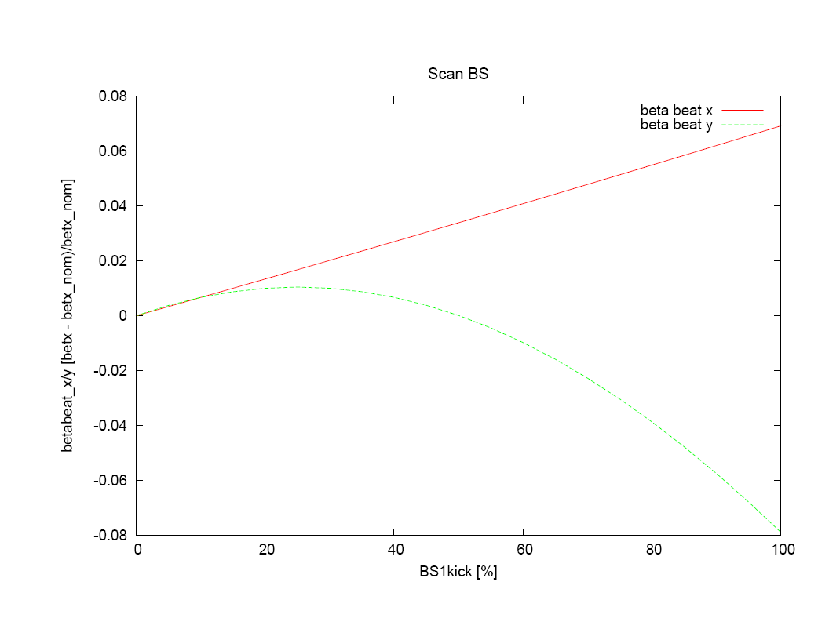

RBEND
SBEND
RBEND-CF
SBEND-CF

Slide 4

SBEND-0.5 ANGLE

Slide 5
S/RBEND-CF magnet shim
  Strength of extra edge focusing for RBEND :
k ≈ ϕ²/(2*L²)
  Assuming magnets of 0.37 m length L, and bend angle ϕ of 66 mrad, required normalised gradient is 0.016 T/m/m, or a real gradient of 0.016 * B.ρ = 0.03 T/m/m.
  With magnetic rigidity 1.9 Tm, the field in BS magnet is about 0.34 T.
  For a horizontal gap width of 0.2 m, the relative change in field is
  0.03* 0.2 / 0.34 = 1.8%
  For 80 mm gap height, change of 1.4 mm would suffice (i.e. ±0.72 mm top and bottom)
SBEND and SBEND-0.5 shim lengths
  For 0.2 m wide SBEND, shim length is 2 x 6.6 = 13.2 mm
  For 0.2 m wide SBEND-0.5, shim length is 2 x 3.3 = 6.6 mm

Slide 6
Resulting effects
SBEND-CF, RBEND-CF and SBEND-0.5 give exactly the same effect optically (note change of gradient sign needed between SBEND-CF and RBEND-CF).
Vertical gap shim sizes is about ±0.72 mm for 80 mm gap
Longitudinal shim length is about 13.2 mm for SBEND, 6.6 mm for SBEND-0.5

Slide 7
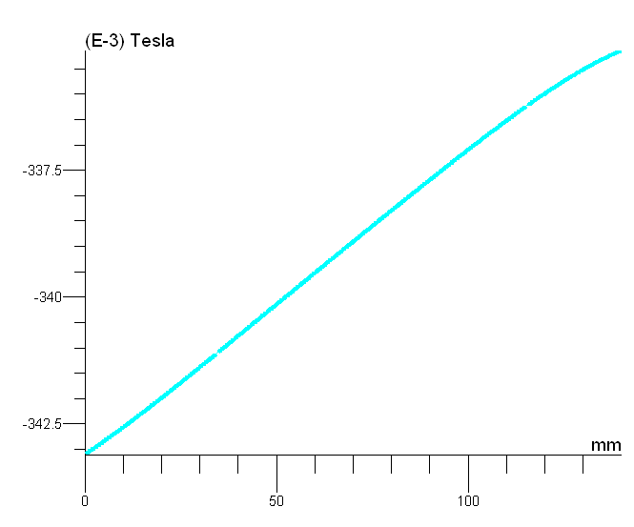
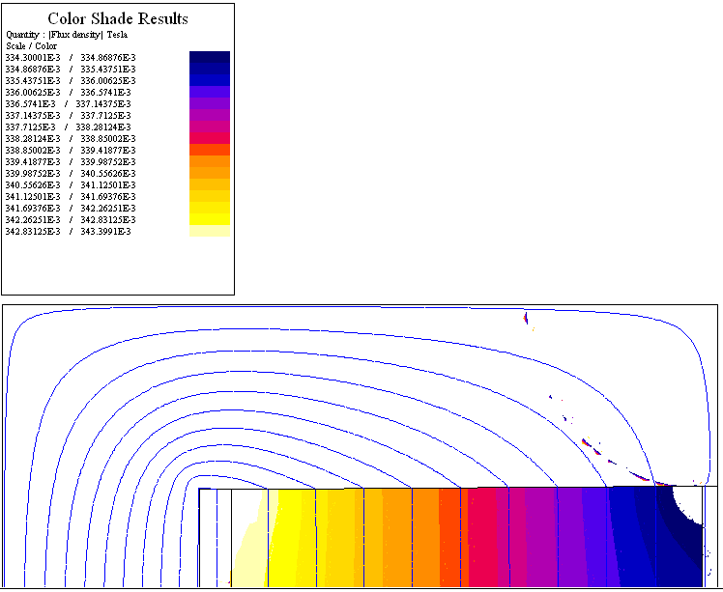
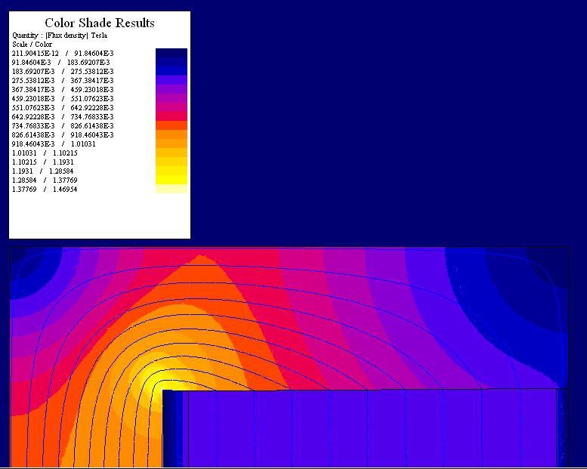
Idealized Rbend – comb. f. (Flux2D)

Slide 8
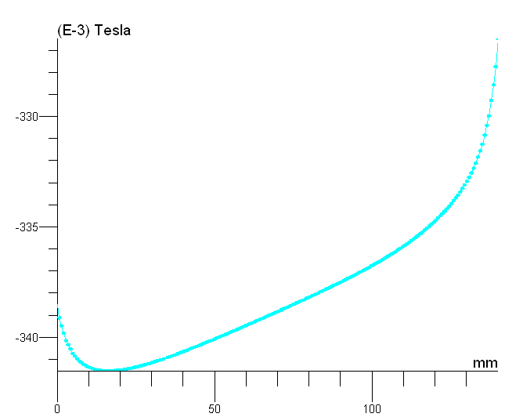
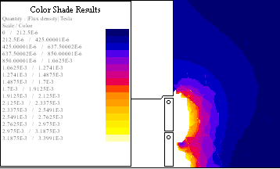
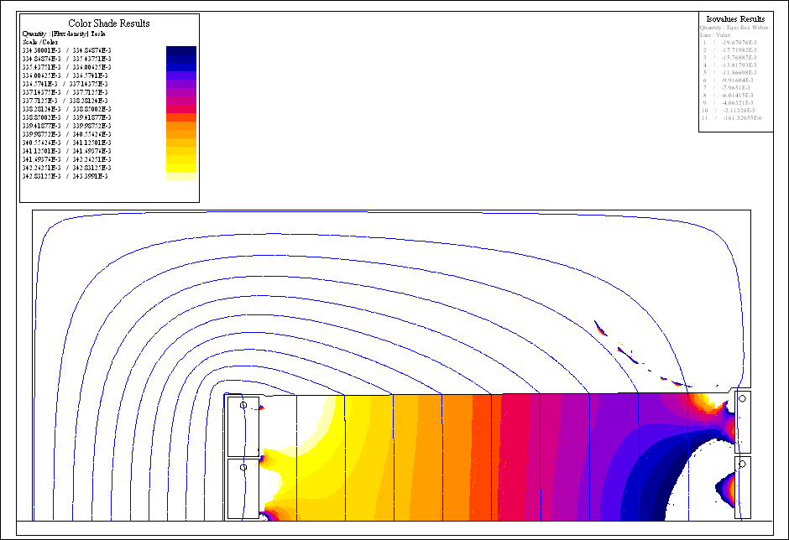
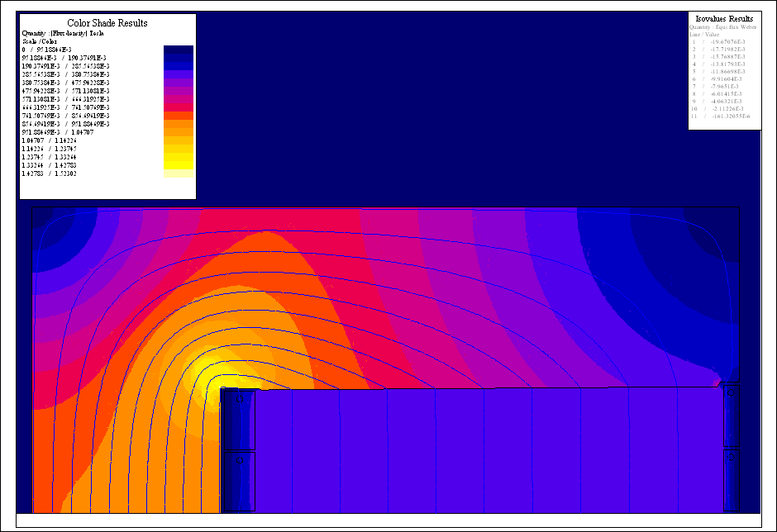
4 turn Rbend – comb. f. (Flux2D)
<- B field variation on the horizontal mid-plane in the gap
B field below 1% of main gap field at 10 mm from the septum ->

Slide 9
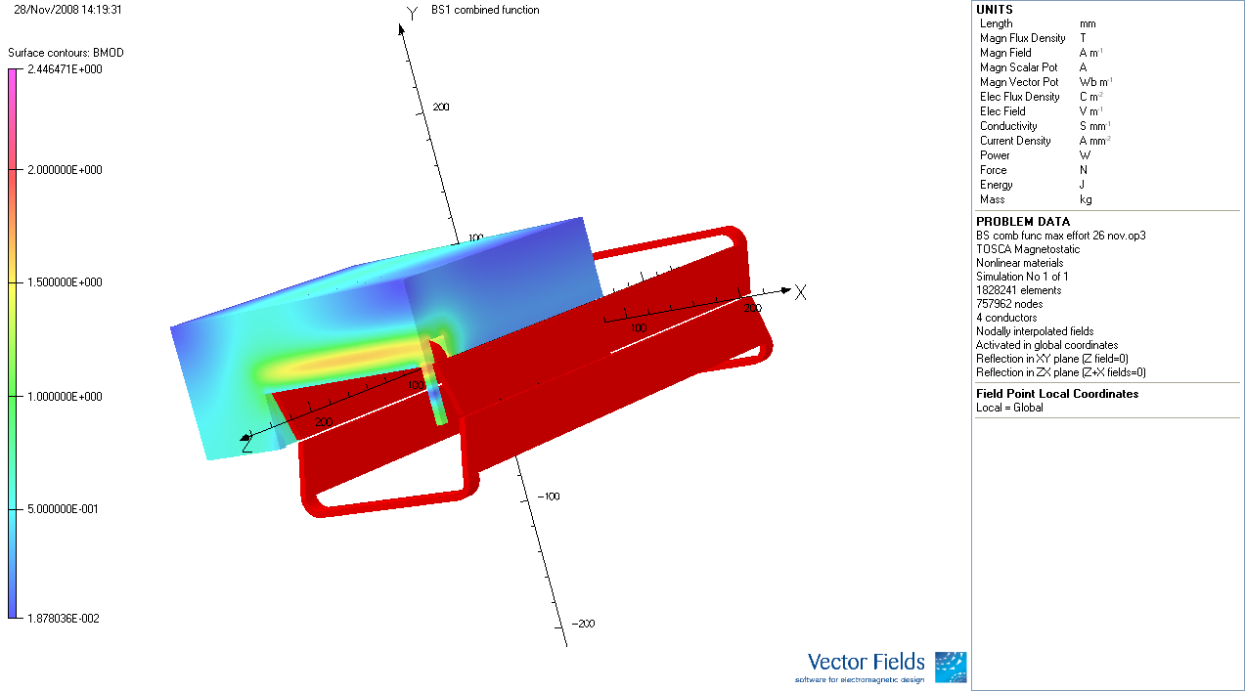
3D model of Rbend (CF!)
Physical length of magnet 400 mm

Slide 10
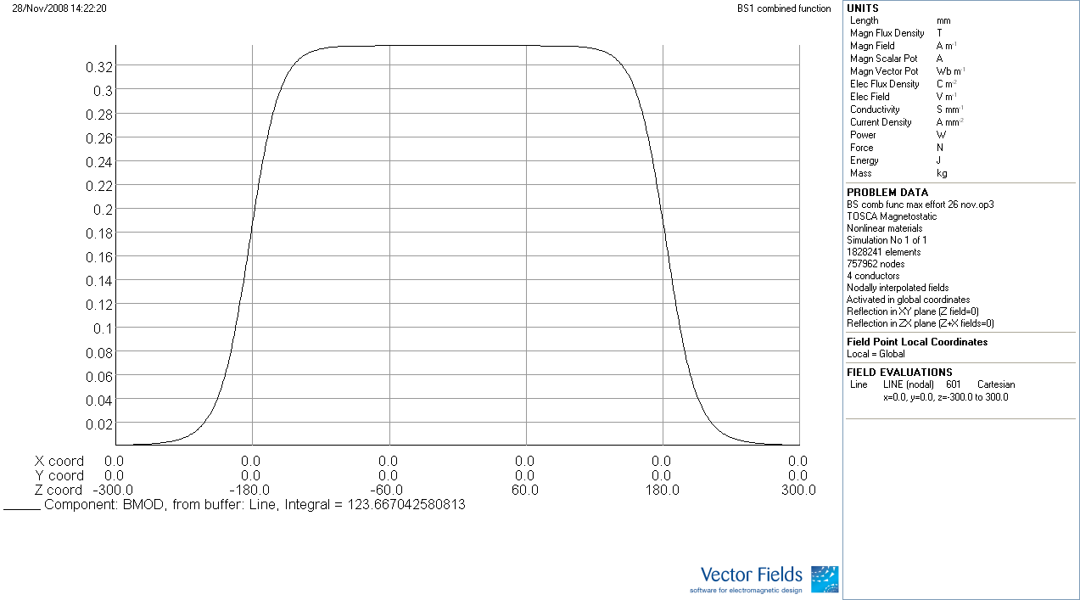
Field in magnet centre
B(0,0,0) = 0.33635 T -> Leq = 368 mm

Slide 11
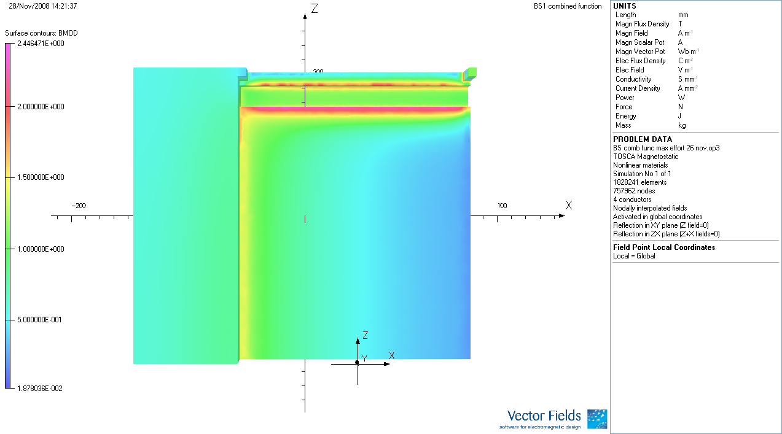
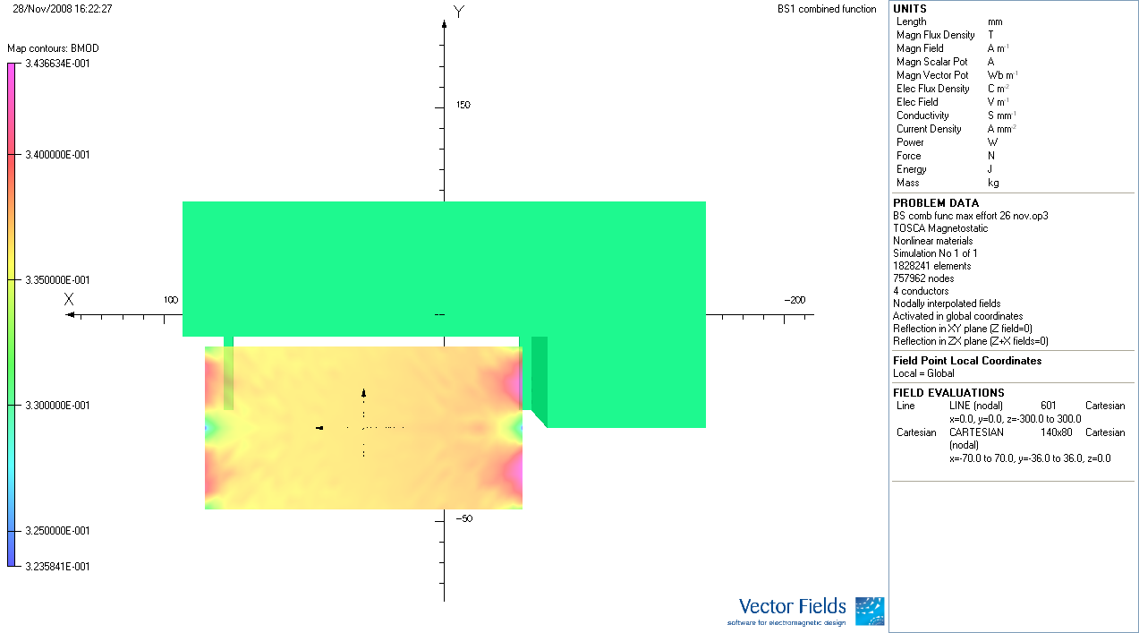
Quadrupolar effect on pole face visible due to non-linear steel.
Field homogeneity inside the gap.

Slide 12
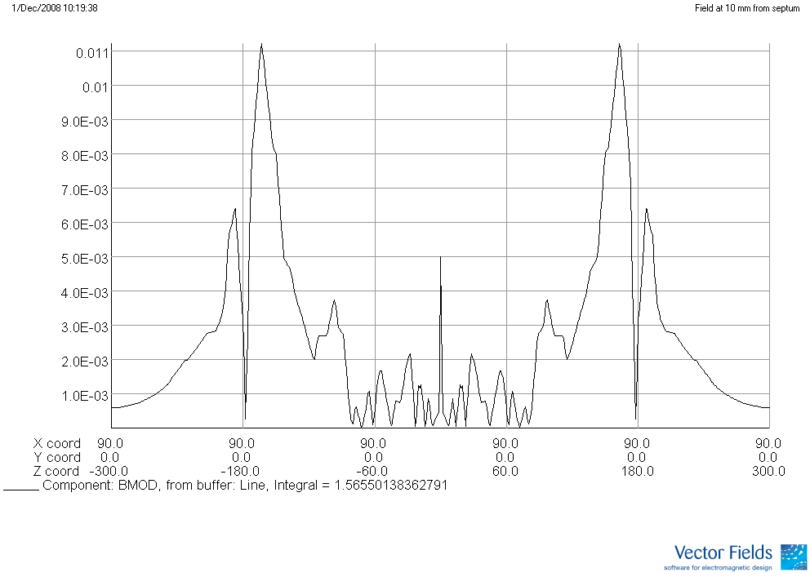
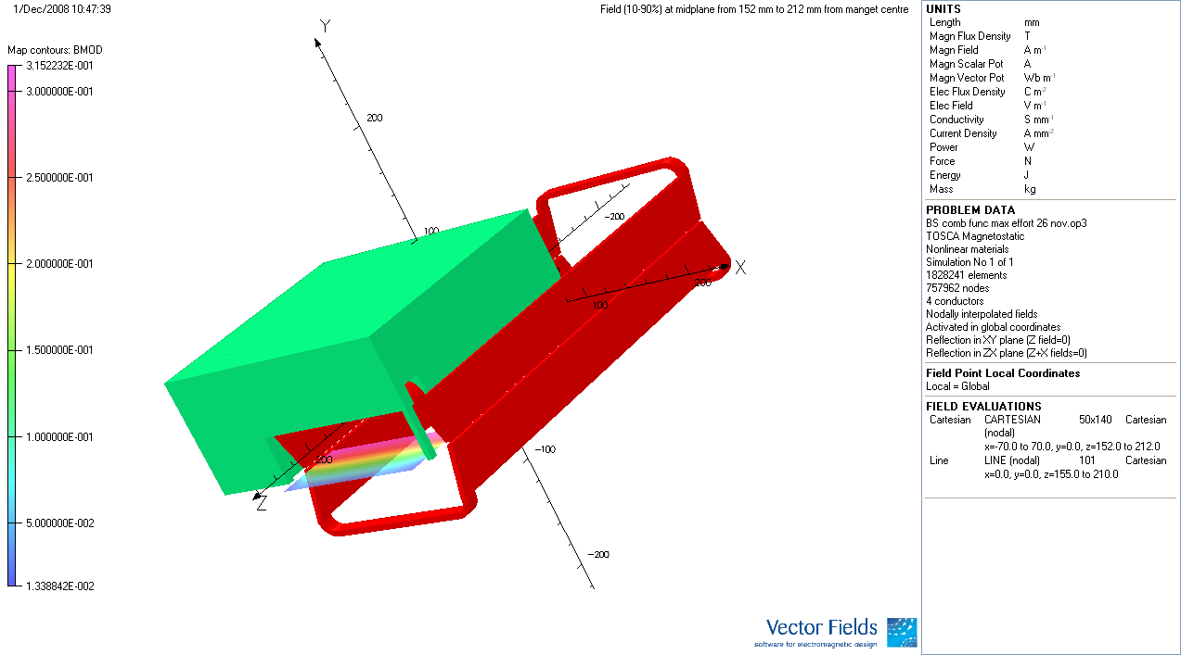
Integrated field at 10 mm from the septum is expected to be in the 1% region (coherent with 2D forecast), but 3D mesh is not most suitable to determine this precisely
Field (90-10%) drop 152 mm to 212 mm from magnet centre (99-1% from 125 mm to 255mm)

Slide 13
Conclusion (1/2)
RBEND-CF can reduce beta beating effect compared to RBEND, with optically the same results as “SBEND-0.5”.
Vertical gap variation would be about ±0.72 mm for 80 mm gap.
RBEND-CF yoke manufacture classical compared to SBEND yokes (tapered ends).
Coil for RBEND-CF would be equally complex to manufacture as for SBEND (different septum and rear conductor heights vs. bend coil heads).
Since yoke construction is more industrial and coil manufacture requires in any case a lot manual work, the RBEND-CF would be preferred.

Slide 14
Conclusion (2/2)
3D model of RBEND (CF) predicts magnetic length of 370 mm can be obtained with 400 mm long magnet.
Without special features, the stray field as seen by injected beam will would be less than 1% of gap field.
Endfield decays from 90 – 10% over 60 mm.
Quadrupolar effect induced by eddy currents in vacuum chamber will have to be taken into account for pole shape (shim) design (but this can only be done once chicane decay time is decided)

