Slide 1
Feasibility Study of
BS Magnets Vacuum Chambers
W. Weterings

Slide 2
Inside vacuum proposal from previous meeting
Chamfer for access
No Space for PSB
Down-Stream bellow
Recess flanges

Slide 3
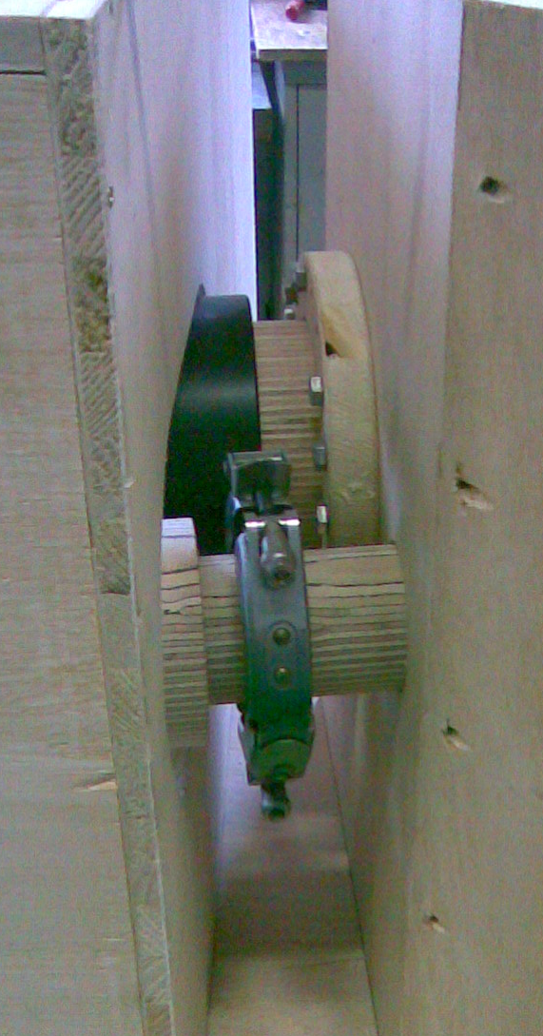
Flange bolted on tank not desirable
In-situ welding
compact “welded Bellows”
no space for QD flanges
Bolted Flange on tank

Slide 4
New proposal with DN135 QD Flanges
Chamfer for access
No Space for PSB
Down-Stream bellow
Recess flanges

Slide 5
No In-situ welding
DN135 QD flanges
But still issue of
Bake-out & maintenance

Slide 6
Initial design of BS Magnets with undulated Inconel chambers

Slide 7
Conclusion PSB beam dynamics WG meeting on 19th November:
Eddy current effects in corrugated INCONEL chamber during (5ms) chicane fall an issue
  Make sure that delays between different BS magnets are not too different
  Sextupolar components not an issue!!
  Perturbation due to quadrupolar components by feed‐down
    Sizable (a bit smaller than edge focusing by BS magnets)
    Should be taken into account for compensation (in particular for injections with the vertical tune above the half‐integer resonance)
ProbabIy not (yet?) the end for BS magnets around
corrugated chambers … can one improve the situation?
What about ceramic vacuum chambers (see discussion with
J. Borburgh)?

Slide 8
BS magnets with ceramic chambers - 1
BS1
BS2-3
BS4

Slide 9
BS magnets with ceramic chambers - 2

Slide 10
BS magnets with ceramic chambers - 3

Slide 11
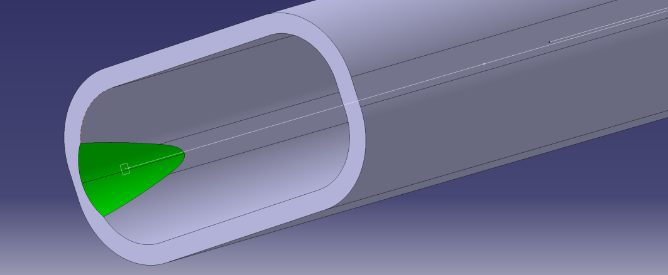
BS magnets with ceramic chambers - 4
Possible
Solution

Slide 12
Conclusion
Inside Vacuum Tanks
  Feasible, but….
    Large bulky tanks
    Bake-out required
    Intervention difficult and time-consuming
Undulated Inconel Chambers
  Feasible, but….
    Eddy current effects
    Optics perturbations
Ceramic Chambers
  Feasible, but….
    Aperture restrictions for BS1
    Procurement / Price of ceramic chambers
    Fragile

