Slide 1
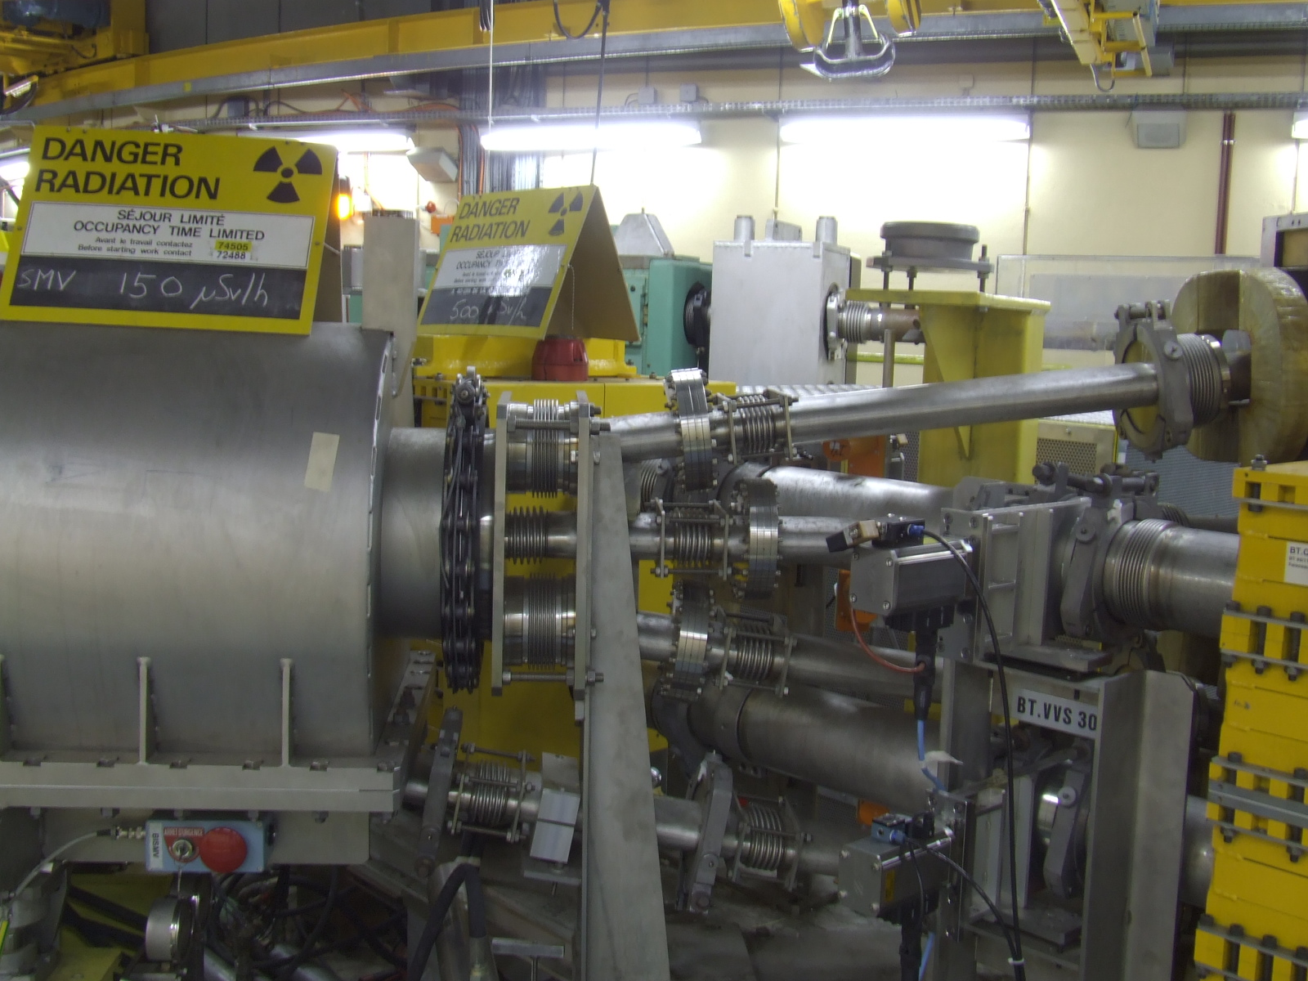
4th SMV magnet cost estimate
J. Borburgh, M. Hourican

Slide 2
Past experience
2 SMH16 magnets cost (1999):
70 kCHF components (accounted for)
10 kCHF screw, UHV cleaning, and surface treatments (est.)
30 kCHF (2 coils)
→ 110 kCHF for 2 magnets
→55 kCHF/Magnet (1999)

Slide 3
Presently budgeted in EVM
Coils (9): 135 kCHF
Misc parts: 135 kCHF
Magnets assembled: 300 kCHF
→570 kCHF for 9 magnets
→63 kCHF/Magnet

Slide 4
Estimated cost
Magnet: 60 kCHF
Tank modifications: 3 kCHF
Electrical connection: 10 kCHF
Internal magnet support: 5 kCHF
Add. bake out system: 2 kCHF
→ 80 kCHF/Magnet
Note: this assumes SMV1 will be run electrically in series with SMV‘head’
Total additional cost : 240 kCHF

Slide 5
4-magnet Assembly (External Dump)
External Dump (will allow more shielding)
Advantages:
Less radiation for magnets
No detrimental vacuum effects
BISMV magnets and dump can be serviced independently
Head dump functionality will be reduced (no magnet protection required)

