Slide 1
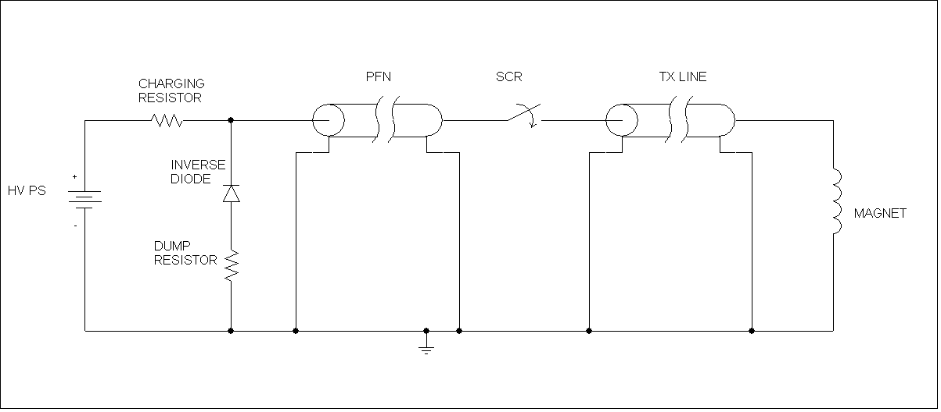
PFN & closing switch
Can use high current SCR switch (e.g FHCT as per MKD)
Switch voltage determined by magnet current and system impedance
Fall-time determined by magnet inductance and system impedance (L/Z)

Slide 2
PFN & closing switch
 |  | BS1,4 | BS2,3
Deflection angle | mrad | 92 | 100
Integrated field | mTm | 175 | 190
Gap field | mTm | 700 | 760
Gap height | mm | 46 | 46
Gap width | mm | 110 | 170
Magnetic length | mm | 250 | 250
Number of turns |  | 1 | 2 | 4 | 8 | 10
Inductance | uH | 1.16102337 | 4.64409 | 18.5764 | 74.3055 | 116.102
Current | A | 27820.2841 | 13910.1 | 6955.07 | 3477.54 | 2782.03
Voltage, kV |  | PFN impedance
20 |  | 0.72 | 1.44 | 2.88 | 5.75 | 7.19
30 |  | 1.08 | 2.16 | 4.31 | 8.63 | 10.78
40 |  | 1.44 | 2.88 | 5.75 | 11.50 | 14.38
80 |  | 2.88 | 5.75 | 11.50 | 23.00 | 28.76
Double magnet power supply possible
Switch may need development for 60us operation
Voltage, kV |  | Fall-time (us), 5 time constants, Single magnet
20 |  | 8.08 | 16.15 | 32.30 | 64.60 | 80.75
30 |  | 5.38 | 10.77 | 21.53 | 43.07 | 53.83
40 |  | 4.04 | 8.08 | 16.15 | 32.30 | 40.38
80 |  | 2.02 | 4.04 | 8.08 | 16.15 | 20.19
Voltage, kV |  | Fall-time (us), 5 time constants, Double magnet
20 |  | 16.15 | 32.30 | 64.60 | 129.20 | 161.50
30 |  | 10.77 | 21.53 | 43.07 | 86.13 | 107.67
40 |  | 8.08 | 16.15 | 32.30 | 64.60 | 80.75
80 |  | 4.04 | 8.08 | 16.15 | 32.30 | 40.38

Slide 3
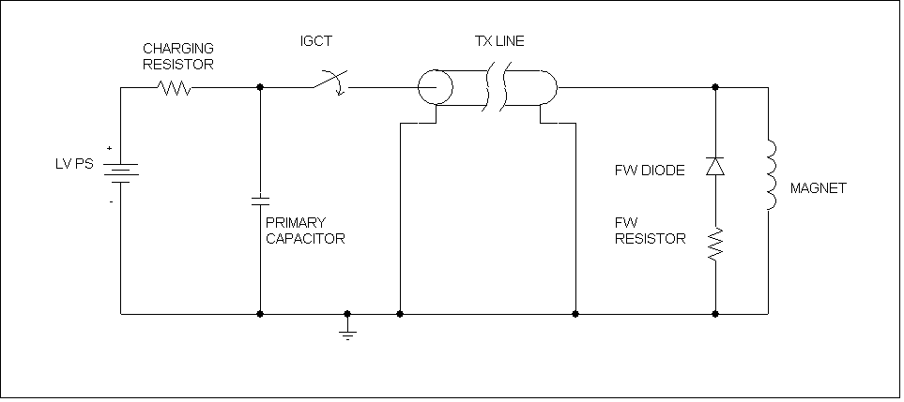
Opening/Closing switch and Freewheel resistor
Need high voltage open/close switch (e.g IGCT, limited to ~4kA peak current, or IGBT in parallel/series)
Fall-time determined by magnet inductance and FW resistor
Switch voltage (maximum < 30kV?) determined by magnet current and fall-time

Slide 4
Opening/Closing switch and Freewheel resistor
 |  | BS1,4 | BS2,3
Deflection angle | mrad | 92 | 100
Integrated field | mTm | 175 | 190
Gap field | mTm | 700 | 760
Gap height | mm | 46 | 46
Gap width | mm | 110 | 170
Magnetic length | mm | 250 | 250
Number of turns |  | 1 | 2 | 4 | 8 | 10
Inductance | uH | 1.16102337 | 4.64409 | 18.5764 | 74.3055 | 116.102
Current | A | 27820.2841 | 13910.1 | 6955.07 | 3477.54 | 2782.03
Fall-time |  | Max. voltage, V
40 | µs | 4037.5 | 8075 | 16150 | 32300 | 40375
60 | µs | 2692 | 5383 | 10767 | 21533 | 26917
100 | µs | 1615 | 3230 | 6460 | 12920 | 16150
250 | µs | 646 | 1292 | 2584 | 5168 | 6460
Single magnet power supply only
Switch may need development for 60us operation
Outside vacuum magnet, vert aperture =85mm
Number of turns |  | 1 | 2 | 4 | 8 | 10 | 20
Inductance | uH | 0.6283185 | 2.51327 | 10.0531 | 40.2124 | 62.8319 | 251.327
Current | A | 51407.047 | 25703.5 | 12851.8 | 6425.88 | 5140.7 | 2570.35

